Slide 2
Unsupervised Learning
Hakim Qahtan
Department of Information and Computing Sciences
Utrecht University

Slide 3
Topics for Today
Unsupervised learning models
Clustering
Partitioning (K-means as example)
Density based clustering (DBSCAN)
Hierarchical clustering
Spectral Clustering
Evaluating the clustering models

Slide 4
Unsupervised Learning
Pattern Discovery
Data
Computer
Model

Slide 5
Unsupervised Learning Models
Unsupervised learning models include:
Clustering (the most common unsupervised task)
Dimensionality reduction
Association rules
Outlier detection
Novelty detection
…
Now we are focusing on – Clustering

Slide 6
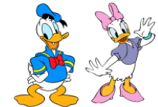


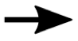

Supervised VS Unsupervised Learning
Learn with supervision: train a model with labelled data
Duck
Supervised
Learning
?
Rabbit
Mouse
*

Slide 7
Supervised VS Unsupervised Learning
Learn with supervision: train a model with labelled data
Duck
Supervised
Learning
?
Rabbit
Mouse
Q1: Can you name some algorithms you learned to solve supervised learning problems?
*

Slide 8
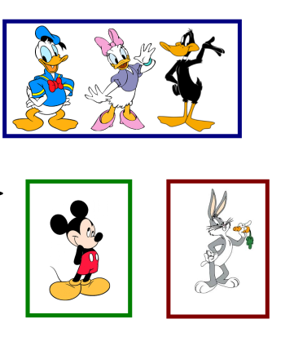
Supervised VS Unsupervised Learning
Learn without supervision: discover hidden patterns in data
Unsupervised
Learning
*

Slide 9

Unsupervised Learning - Clustering
Grouping similar objects together
Organize unlabeled data into similar groups (called clusters)
Similarity can be defined in different ways.
Widely used: healthcare, text mining, computer graphics, etc.
Clustering
*
*
*
Close in the dimensional space
Share similar features

Slide 10
Cluster Analysis
A Cluster: A collection of data objects where
similar (or related) objects fall within the same group
dissimilar (or unrelated) objects fall in different groups
Cluster analysis
Finding similarities between data according to the characteristics found in the data and grouping similar data objects into clusters
Increase intraclass similarity
Decrease interclass similarity
Unsupervised learning: no predefined classes (data labels are not required)

Slide 11
Clustering – Applications
Preprocessing step for other algorithms
Group the set documents for faster retrieval and browsing.
Group stocks with similar price fluctuation
Outlier detection: outliers are often viewed as those “far away” from any cluster
Finding K-nearest Neighbors: Localizing search to one or a small number of clusters
Reduce the size of large datasets
Image segmentation/compression
Privacy preservation (critical data is clustered in one cluster)

Slide 12
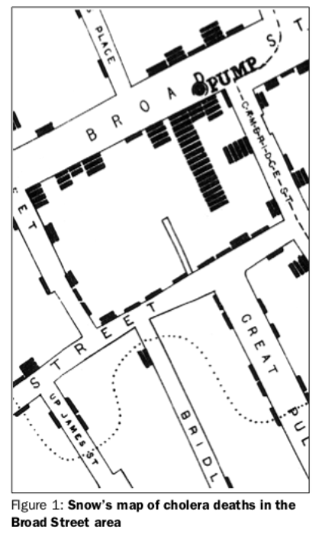
Clustering - A historic application
John Snow, a British physician plotted the location of cholera deaths on a map during the London cholera epidemic in 1854 ^{[1].}
The map was used to indicate the specific clusters, certain intersections, where serious infections were reported.
[1] Brody, Howard, et al. "Map-making and myth-making in Broad Street: the London cholera epidemic, 1854." The Lancet (2000).

Slide 13
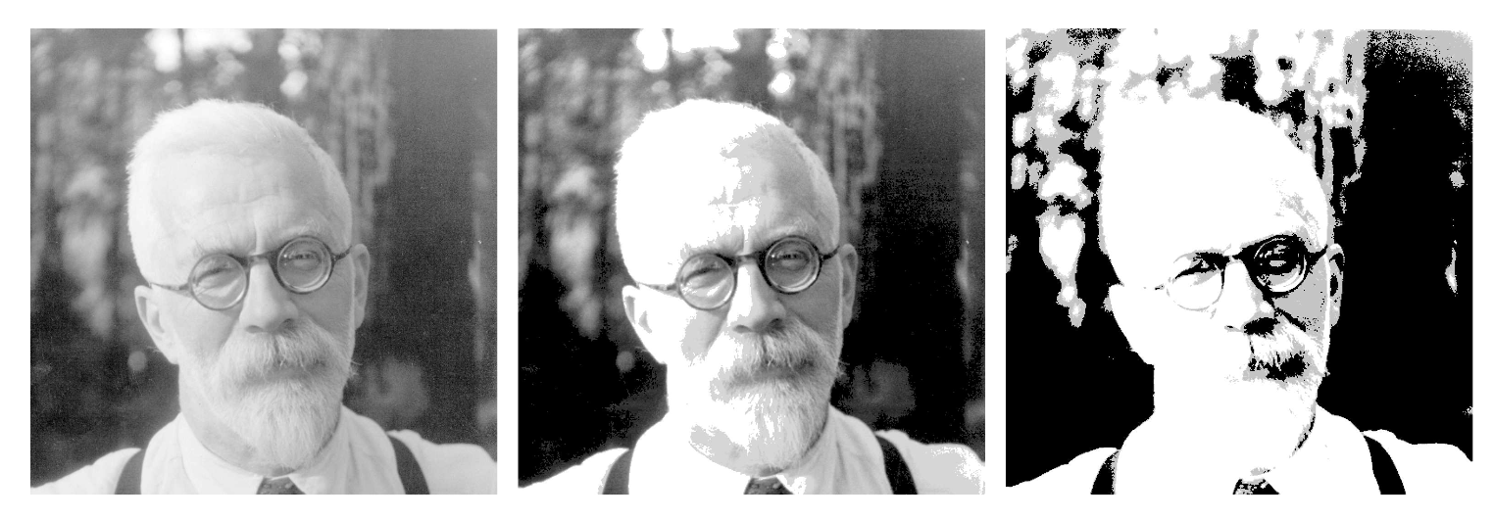
Clustering – Applications
Image compression
- k-means clustering applied to image processing Goal: image compression -- less storage!
Cluster blocks of 4 pixels, then replace blocks by their cluster centroid
Original (1MB)
K = 200 (0.2375 MB)
K = 4 (0.0625 MB)

Slide 14
What is a Good Clustering Technique?
The quality of a clustering method depends on
the similarity measure used by the method
its implementation, and
Its ability to discover some or all of the hidden patterns
A good clustering method will produce high quality clusters
high intra-class similarity: cohesive within clusters
low inter-class similarity: distinctive between clusters

Slide 15
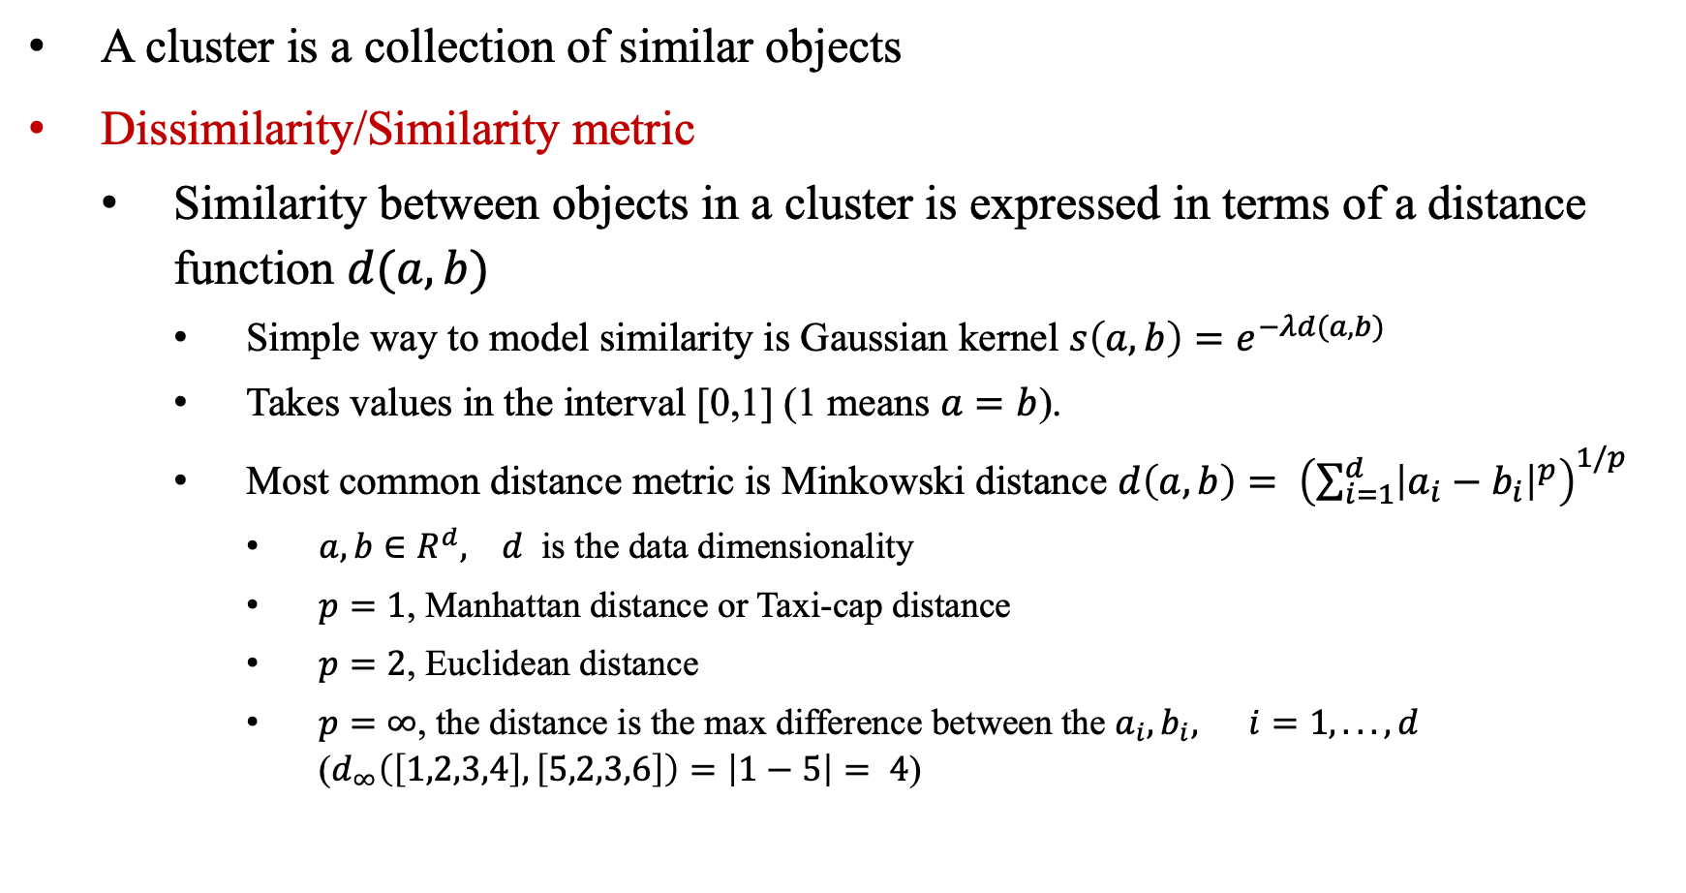
Measuring the Similarity between Objects
A cluster is a collection of similar objects
Dissimilarity/Similarity metric
Similarity between objects in a cluster is expressed in terms of a distance function $d(a,b)$
Simple way to model similarity is Gaussian kernel $s\left(a,b\right)=e^{−λd(a,b)}$
Takes values in the interval [0,1] (1 means $a=b$).
Most common distance metric is Minkowski distance $d\left(a,b\right)= {\left(\sum_{i=1}^{d}{{\left|a_{i}−b_{i}\right|}^{p}}\right)}^{1/p}$
$a, b∈R^{d}, d$ is the data dimensionality
$p=1$, Manhattan distance or Taxi-cap distance
$p=2$, Euclidean distance
$p=∞$, the distance is the max difference between the $a_{i}, b_{i}, i=1, ..., d$ ($d_{∞}\left(\left[1,2,3,4\right], \left[5,2,3,6\right]\right)=\left|1−5\right|= 4$)

Slide 16
Clustering Techniques

Slide 17
Major Clustering Approaches
Partitioning approach:
Construct various partitions and then evaluate them by some criterion, e.g., minimizing the sum of square errors
Typical methods: k-means, k-medoids, CLARANS
Hierarchical approach:
Create a hierarchical decomposition of the set of data (or objects) using some criterion
Typical methods: Divisive (Diana), Agglomerative (Agnes), BIRCH, CAMELEON
Density-based approach:
Based on connectivity and density functions
Typical methods: DBSACN, OPTICS, DenClue

Slide 18
K-means Clustering

Slide 19
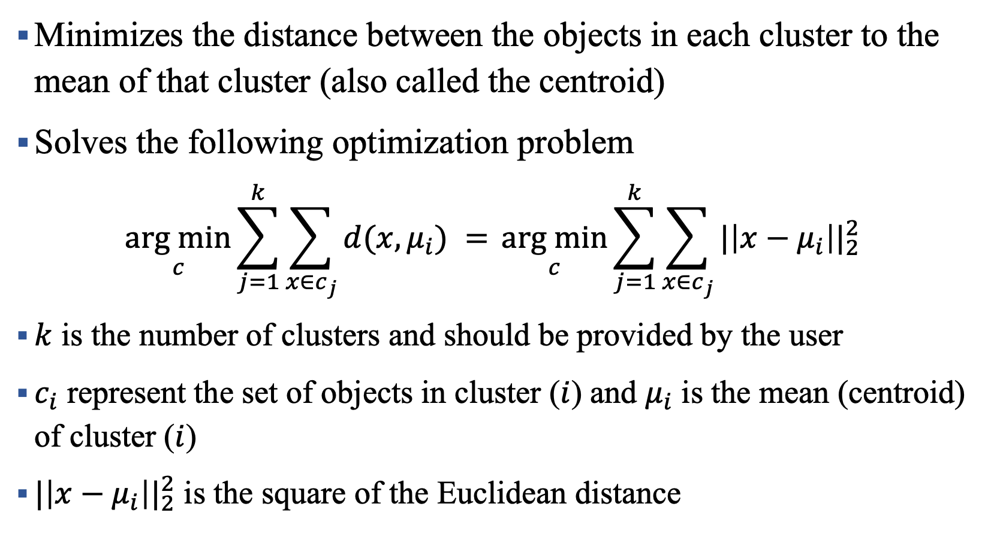
K-means Clustering
Minimizes the distance between the objects in each cluster to the mean of that cluster (also called the centroid)
Solves the following optimization problem
$$\underset{c}{arg min}{\sum_{j=1}^{k}{\sum_{x∈c_{j}}{d(x, μ_{i}) }= }}\underset{c}{arg min}{\sum_{j=1}^{k}{\sum_{x∈c_{j}}{{|\left|x−μ_{i}\right||}_{2}^{2} } }}$$
$k$ is the number of clusters and should be provided by the user
$c_{i}$ represent the set of objects in cluster ($i$) and $μ_{i}$ is the mean (centroid) of cluster ($i$)
${|\left|x−μ_{i}\right||}_{2}^{2}$ is the square of the Euclidean distance

Slide 20
K-means Clustering
Input: the dataset and the number of clusters k
Each cluster is determined by its average point (centroid)
Each point in the dataset is assigned to the cluster with the closest centroid
Algorithm:
Select k points as initial centroids
repeat
Form k clusters by assigning all clusters to the closest centroid
Recompute the centroid of each cluster
until the centroids do not change

Slide 21
K-means Clustering – Pros and Cons
Pros:
Simple, scale well for large number of samples
Computationally efficient
Tighter clusters than the hierarchical clustering
Cons
Difficult to guess the value of k
Cannot handle clusters with arbitrary shapes
Clustering accuracy depends heavily on the initial selection of the centroids
Based on the use of squared Euclidean distance as the measure of dissimilarity
Cluster means are not robust to outliers
May not ensure the convergence to the global minimum

Slide 22
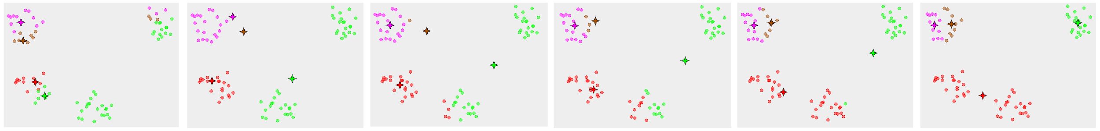

Slide 23
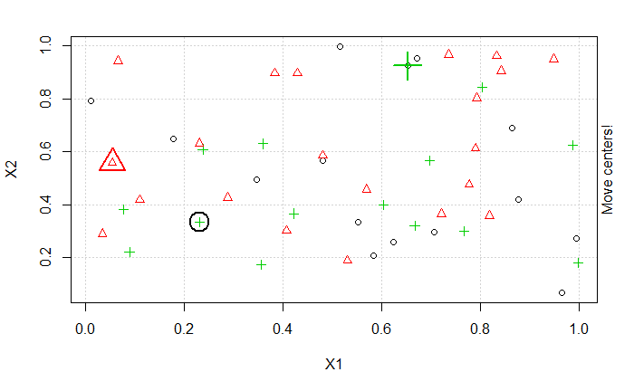
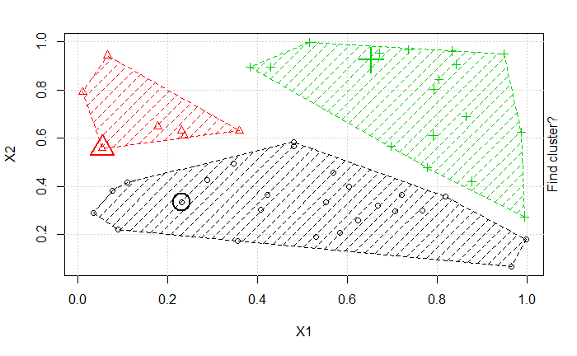
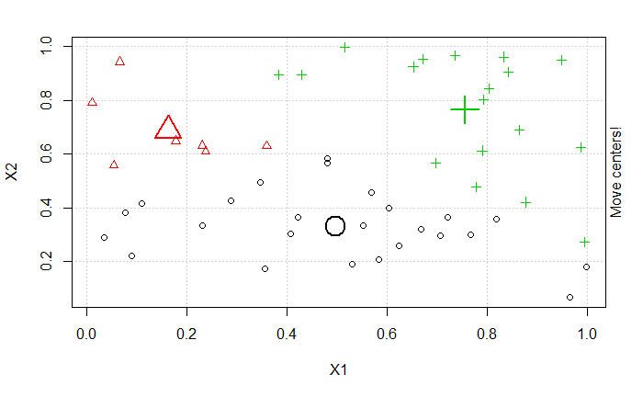
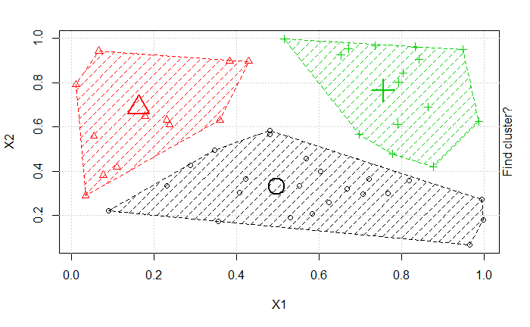
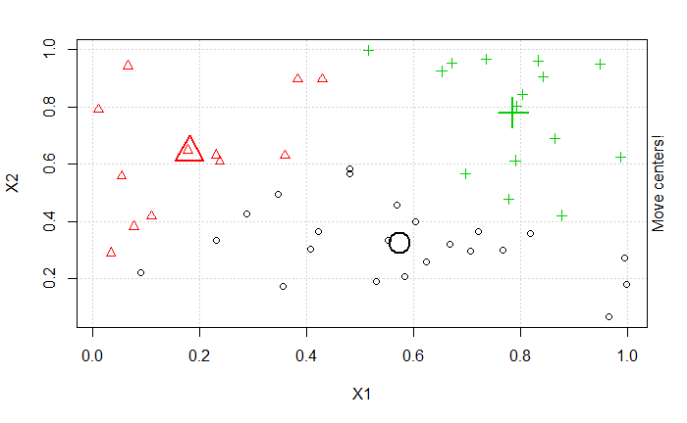
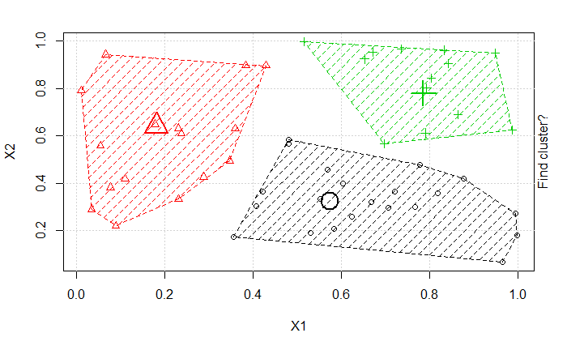
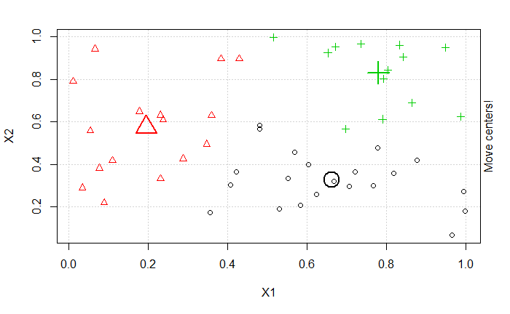
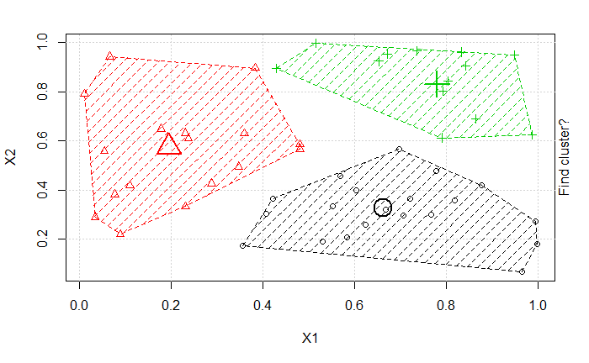
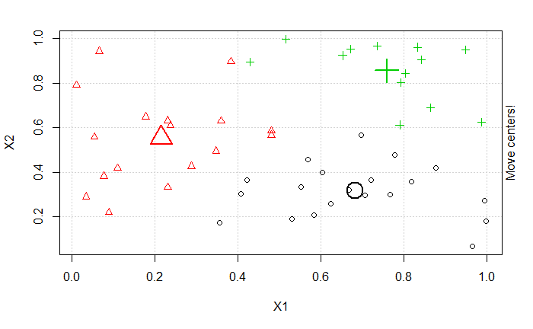
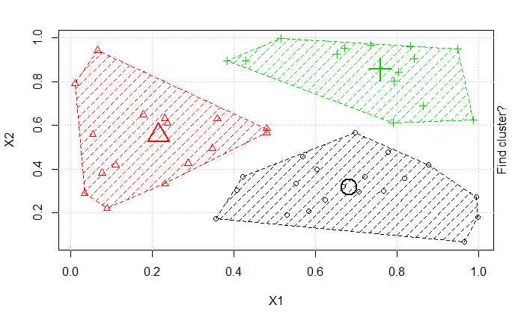
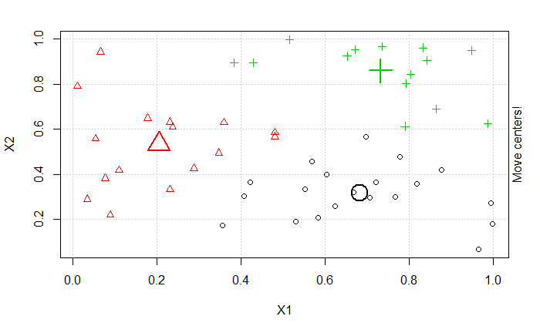
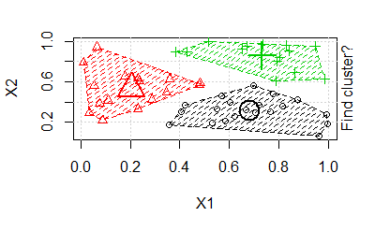
K-means Clustering – Demo

Slide 24

Coding Time

Slide 25

Coffee Break

Slide 26
DBSCAN Clustering

Slide 27
Density Based Clustering Methods
Basic idea: points within density connected region belong to the same cluster
Major Features:
Discover clusters of arbitrary shapes
Handle noise
Single scan over the data
Requirements:
Parameters as terminating conditions
You can look at DBSCAN: Ester, et al. (SIGKDD’96)

Slide 28
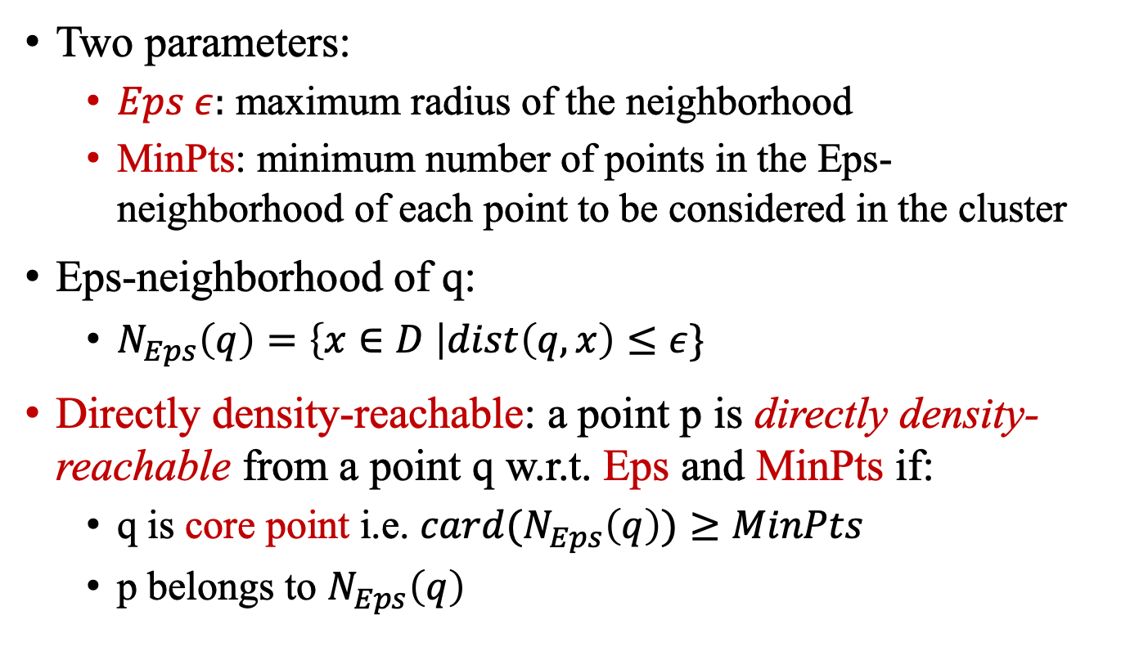
DBSCAN
Two parameters:
$Eps ε:$ maximum radius of the neighborhood
MinPts: minimum number of points in the Eps-neighborhood of each point to be considered in the cluster
Eps-neighborhood of q:
$N_{Eps}\left(q\right)=\left\{x∈D \right|dist\left(q,x\right)≤ε\}$
Directly density-reachable: a point p is directly density-reachable from a point q w.r.t. Eps and MinPts if:
q is core point i.e. ${card(N}_{Eps}\left(q\right))≥MinPts$
p belongs to $N_{Eps}\left(q\right)$
Eps = 1cm
MinPts = 5

Slide 29
DBSCAN
DBSCAN is based on:
Density: number of points within a specified radius (Eps)
Core points: those points which has more than the number of MinPts within Eps-neighborhood
These are the points in the interior of the clusters
Border points: has fewer number of points within Eps-neighborhood but they are in the neighborhood of core points
Noise points: all the points that are neither core points nor border points.

Slide 30
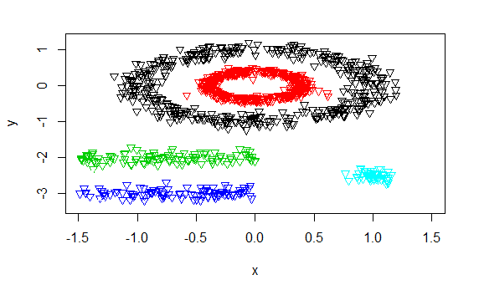
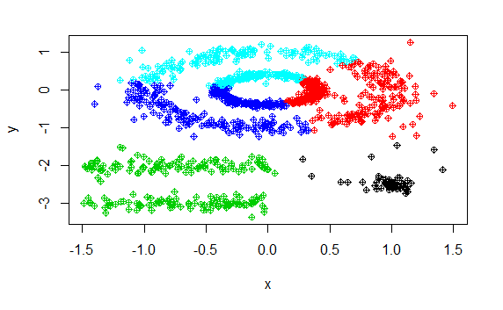
Comparing K-means and DBSCAN
DBSCAN
K-means

Slide 31
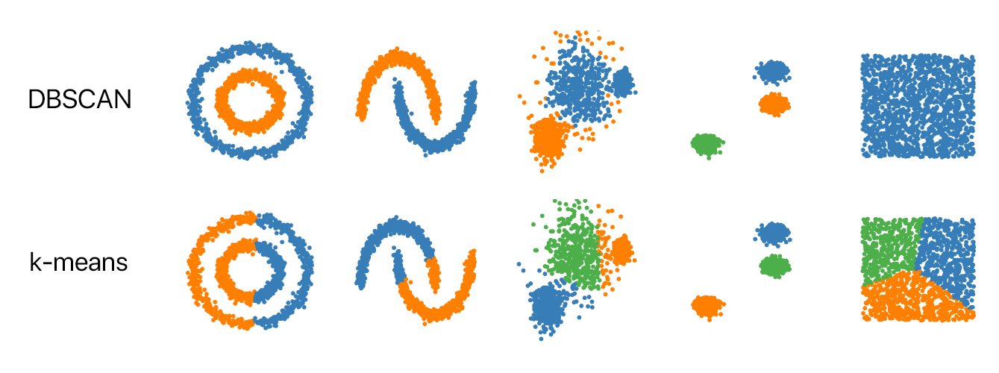
Comparing K-means and DBSCAN
DBSCAN
K-means

Slide 32
Coding Time

Slide 33
Hierarchical Clustering

Slide 34
Hierarchical Clustering
Construct nested clusters by successive merging (agglomerative/bottom up) or splitting (divisive/top down)
The hierarchy of the clusters is represented as a tree which is called dendrogram.
The root represents a single cluster for all the data
The leaves represent clusters with single object

Slide 35
Hierarchical Clustering
Step 0
Step 1
Step 2
Step 3
Step 4
agglomerative
Two approaches
Agglomerative (bottom-up)
Divisive (top-down)
Requires stopping condition
Number of clusters
Agglomerative: similarity between merged clusters is low
Divisive: maximum distance between all possible partition divisions is small
a
a b
b
a b c d e
c
c d e
d
d e
e
divisive
Step 4
Step 3
Step 2
Step 1
Step 0

Slide 36
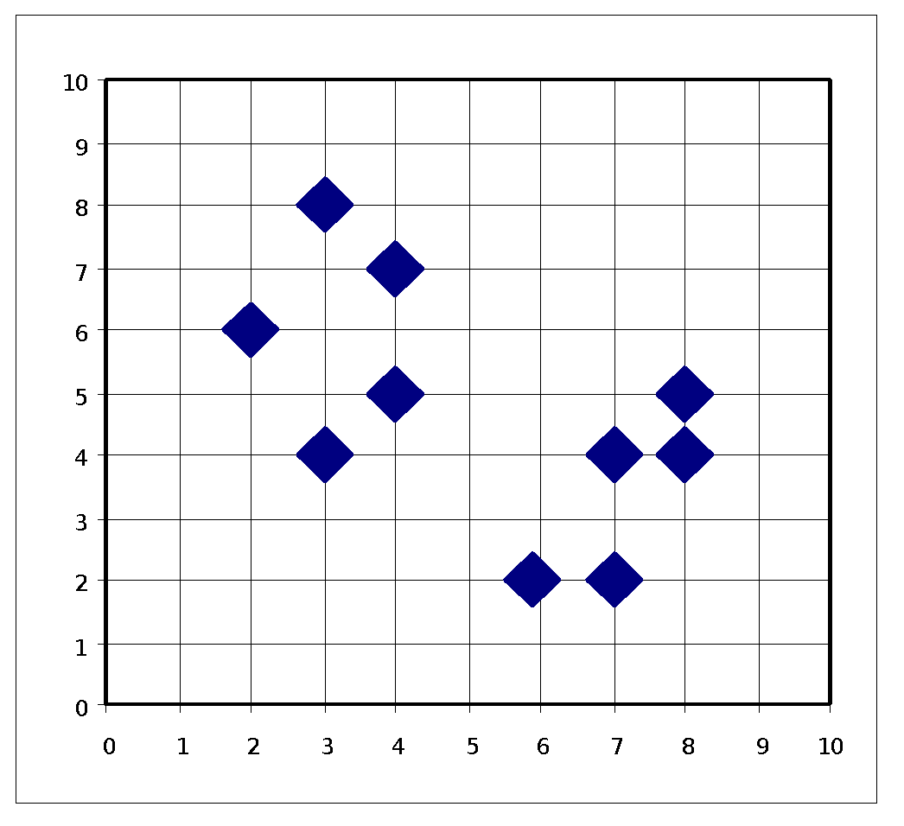
Hierarchical Clustering (Agglomerative)
Also known as bottom-up approach
Start with each object as a cluster in its own
Repeatedly merge nodes that have the least dissimilarity
Go on in a non-descending fashion
At every step, check the stopping condition

Slide 37
Hierarchical Clustering (Divisive)
Also known as top-down approach
Start with assuming all the data belong to the same cluster
Check all possible ways to divide the clusters
Choose the best division (that will reduce intraclass distance and increase interclass distance)
Repeat the process until stopping condition is met

Slide 38
Coding Time

Slide 39
Coffee Break

Slide 40
Spectral Clustering

Slide 41
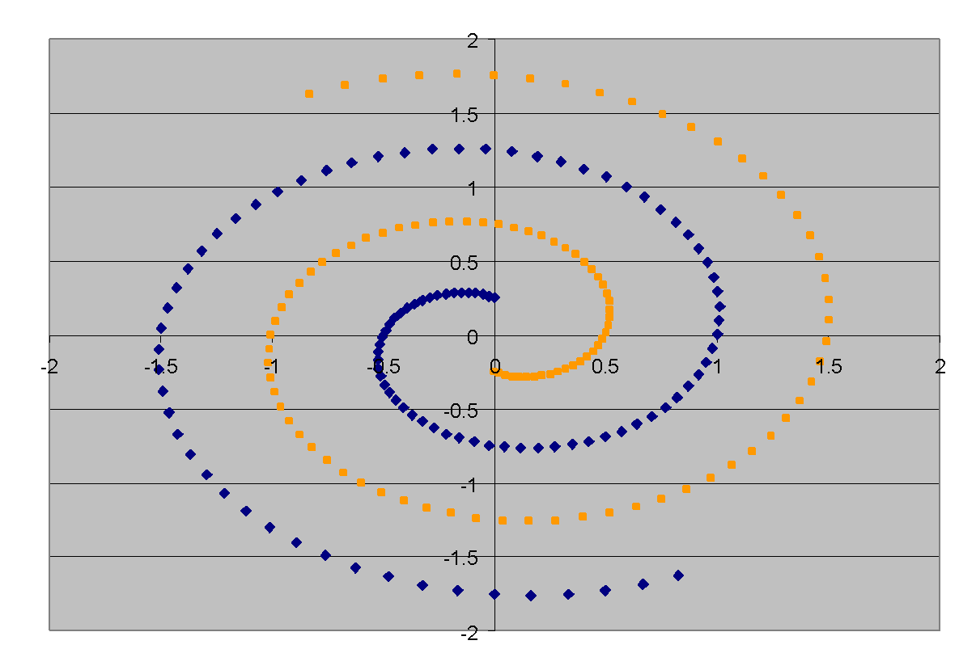
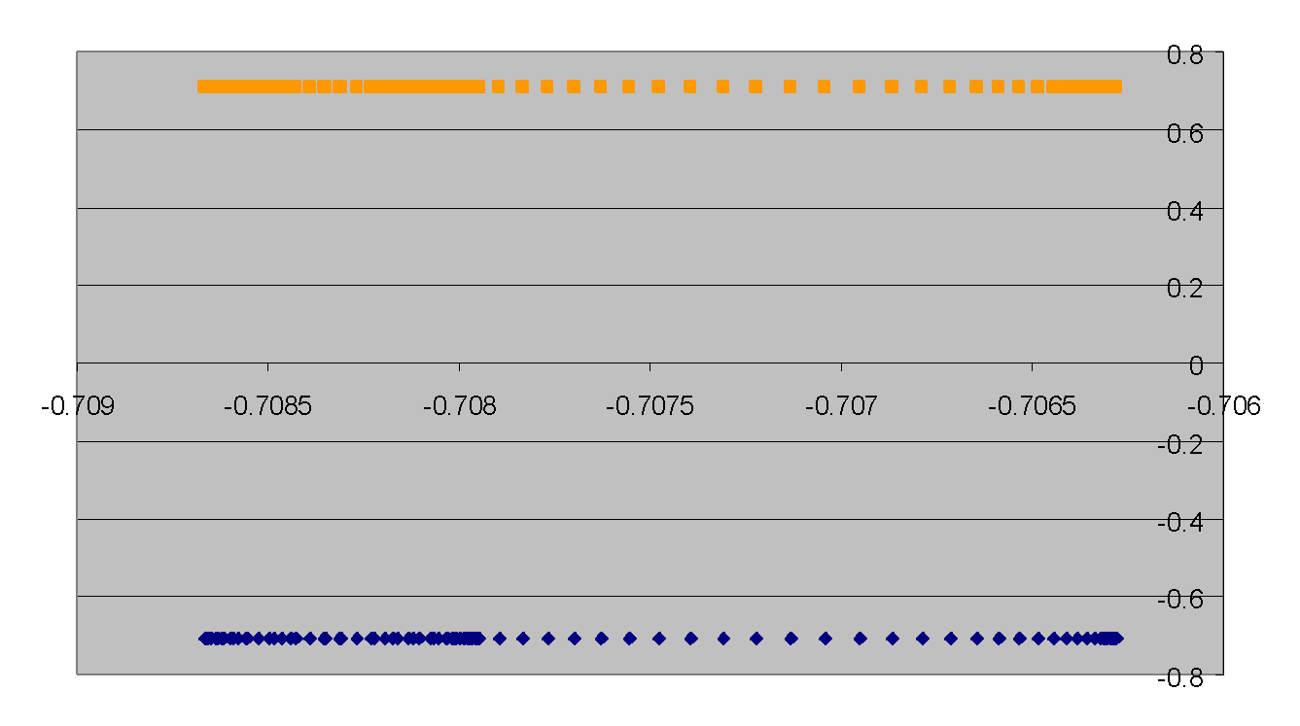
Spectral Clustering
Dataset exhibits complex cluster shapes
K-means performs very poorly in this space due to bias toward dense spherical clusters.
In the embedded space given by two leading eigenvectors, clusters are trivial to separate.

Slide 42
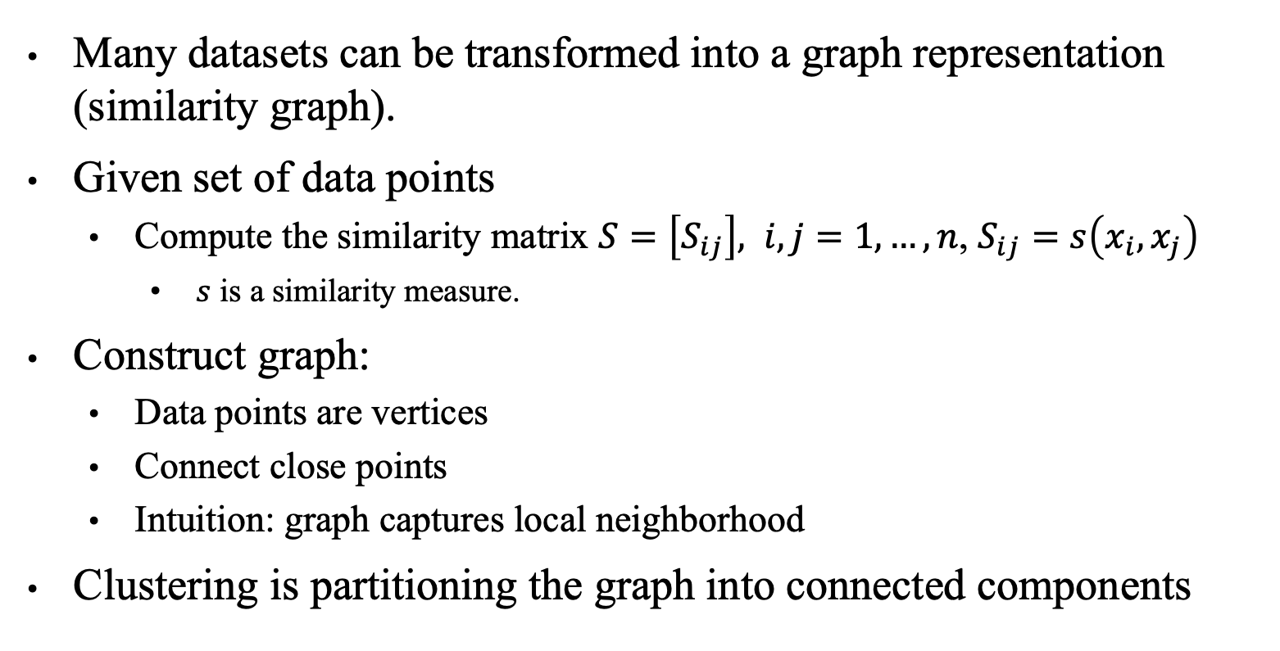
Spectral Clustering
Many datasets can be transformed into a graph representation (similarity graph).
Given set of data points
Compute the similarity matrix $S=\left[S_{ij}\right], i,j=1,…, n$, $S_{ij}=s\left(x_{i},x_{j}\right)$
$s$ is a similarity measure.
Construct graph:
Data points are vertices
Connect close points
Intuition: graph captures local neighborhood
Clustering is partitioning the graph into connected components

Slide 43
Measuring the Clustering Quality

Slide 44
Measuring the Clustering Quality
Two methods: intrinsic vs. extrinsic
Intrinsic: unsupervised, i.e., the ground truth is unavailable
Evaluate the goodness of a clustering by considering how well the clusters are separated, and how compact the clusters are
Ex. Rand Index and Silhouette coefficient
Extrinsic: supervised, i.e., the ground truth is available (for evaluation only)
Compare a clustering against the ground truth using certain clustering quality measure
Ex. Precision and recall metrics

Slide 45
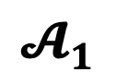
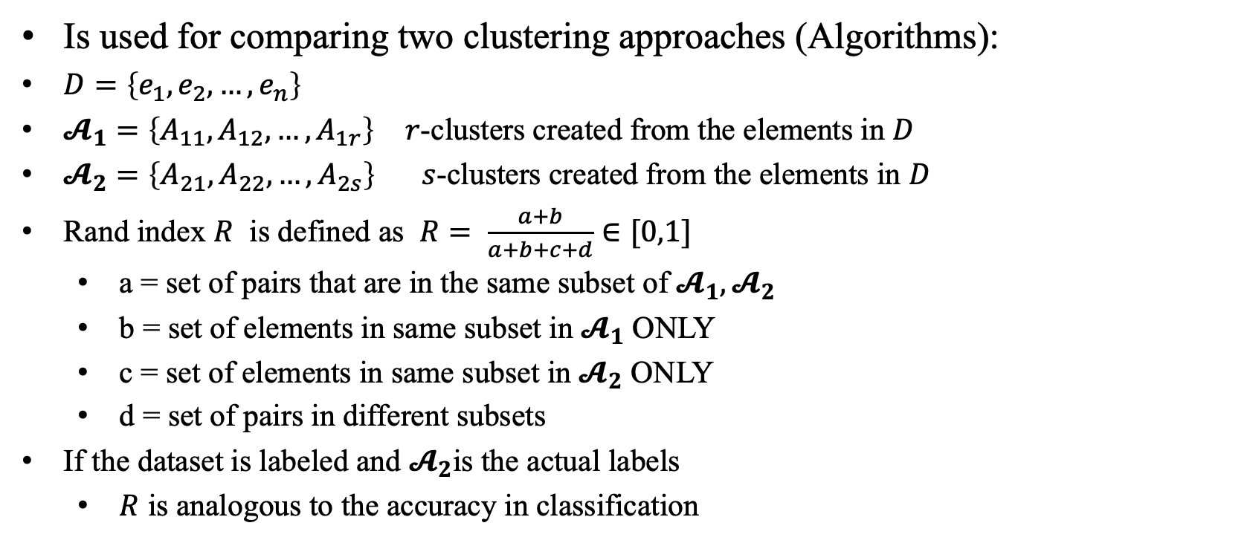
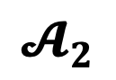
Measuring the Clustering Quality – Rand Index
Is used for comparing two clustering approaches (Algorithms):
$D=\left\{e_{1}, e_{2},…, e_{n}\right\}$
$𝓐_{1}=\left\{A_{11}, A_{12},…, A_{1r}\right\}$ $r$-clusters created from the elements in $D$
$𝓐_{2}=\left\{A_{21}, A_{22},…, A_{2s}\right\}$ $s$-clusters created from the elements in $D$
Rand index $R$ is defined as $R= \frac{a+b}{a+b+c+d}∈[0,1]$
a = set of pairs that are in the same subset of ${𝓐_{1}, 𝓐}_{2}$
b = set of elements in same subset in $𝓐_{1}$ ONLY
c = set of elements in same subset in $𝓐_{2}$ ONLY
d = set of pairs in different subsets
If the dataset is labeled and $𝓐_{2}$is the actual labels
$R$ is analogous to the accuracy in classification
e1
e5
e7
e10
e2
e4
$$𝓐_{1}$$
e8
e6
e4
e3
e3
e9
e8
e9
e10
e7
e5
e2
e1
e6
$$𝓐_{2}$$

Slide 46
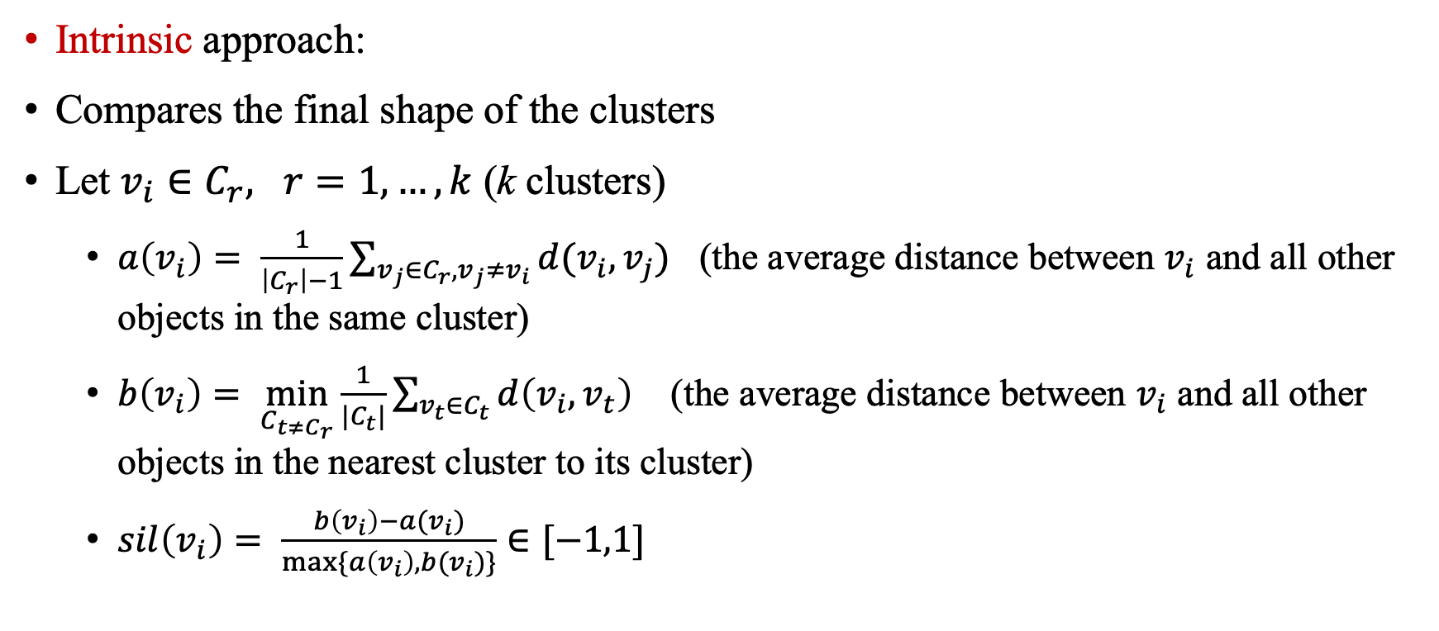
Measuring the Clustering Quality – Silhouette Score
Intrinsic approach:
Compares the final shape of the clusters
Let $v_{i}∈C_{r}, r=1,…,k$ (k clusters)
$a\left(v_{i}\right)= \frac{1}{\left|C_{r}\right|−1}\sum_{v_{j}∈C_{r}, v_{j}≠v_{i}}{d(v_{i},v_{j})}$ (the average distance between $v_{i}$ and all other objects in the same cluster)
$b\left(v_{i}\right)= \min_{C_{t≠C_{r}}}{\frac{1}{|C_{t}|}\sum_{v_{t}∈C_{t}}{d\left(v_{i}, v_{t}\right)}}$ (the average distance between $v_{i}$ and all other objects in the nearest cluster to its cluster)
$sil\left(v_{i}\right)= \frac{b\left(v_{i}\right)−a(v_{i})}{max⁡\{a\left(v_{i}\right), b(v_{i})\}}∈[−1,1]$

Slide 47
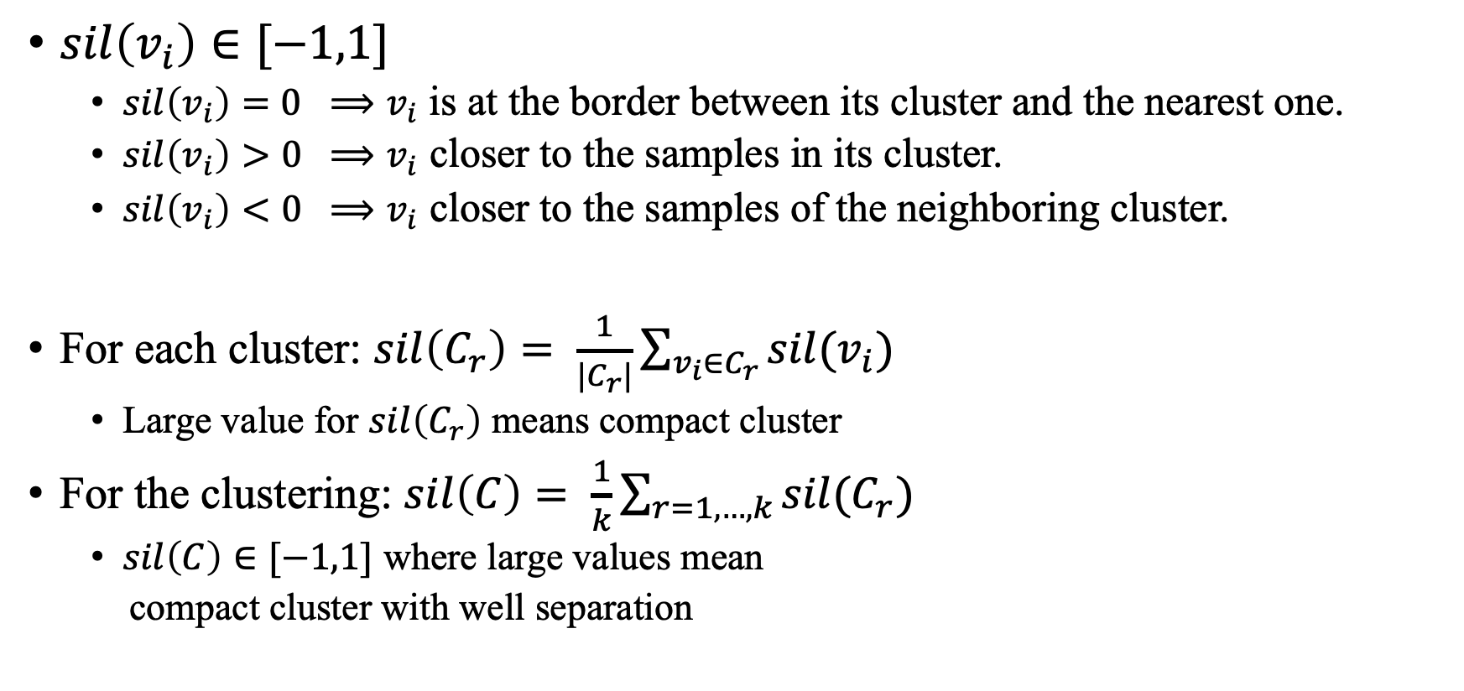
Measuring the Clustering Quality – Silhouette Score
$sil\left(v_{i}\right)∈[−1,1]$
$sil\left(v_{i}\right)=0 ⟹v_{i}$ is at the border between its cluster and the nearest one.
$sil\left(v_{i}\right)>0 ⟹v_{i}$ closer to the samples in its cluster.
$sil\left(v_{i}\right)<0 ⟹v_{i}$ closer to the samples of the neighboring cluster.
For each cluster: $sil\left(C_{r}\right)= \frac{1}{|C_{r}|}\sum_{v_{i}∈C_{r}}{sil(v_{i})}$
Large value for $sil\left(C_{r}\right)$ means compact cluster
For the clustering: $sil\left(C\right)= \frac{1}{k}\sum_{r=1,…,k}{sil(C_{r})}$
$sil\left(C\right)∈[−1,1]$ where large values mean
compact cluster with well separation

Slide 48
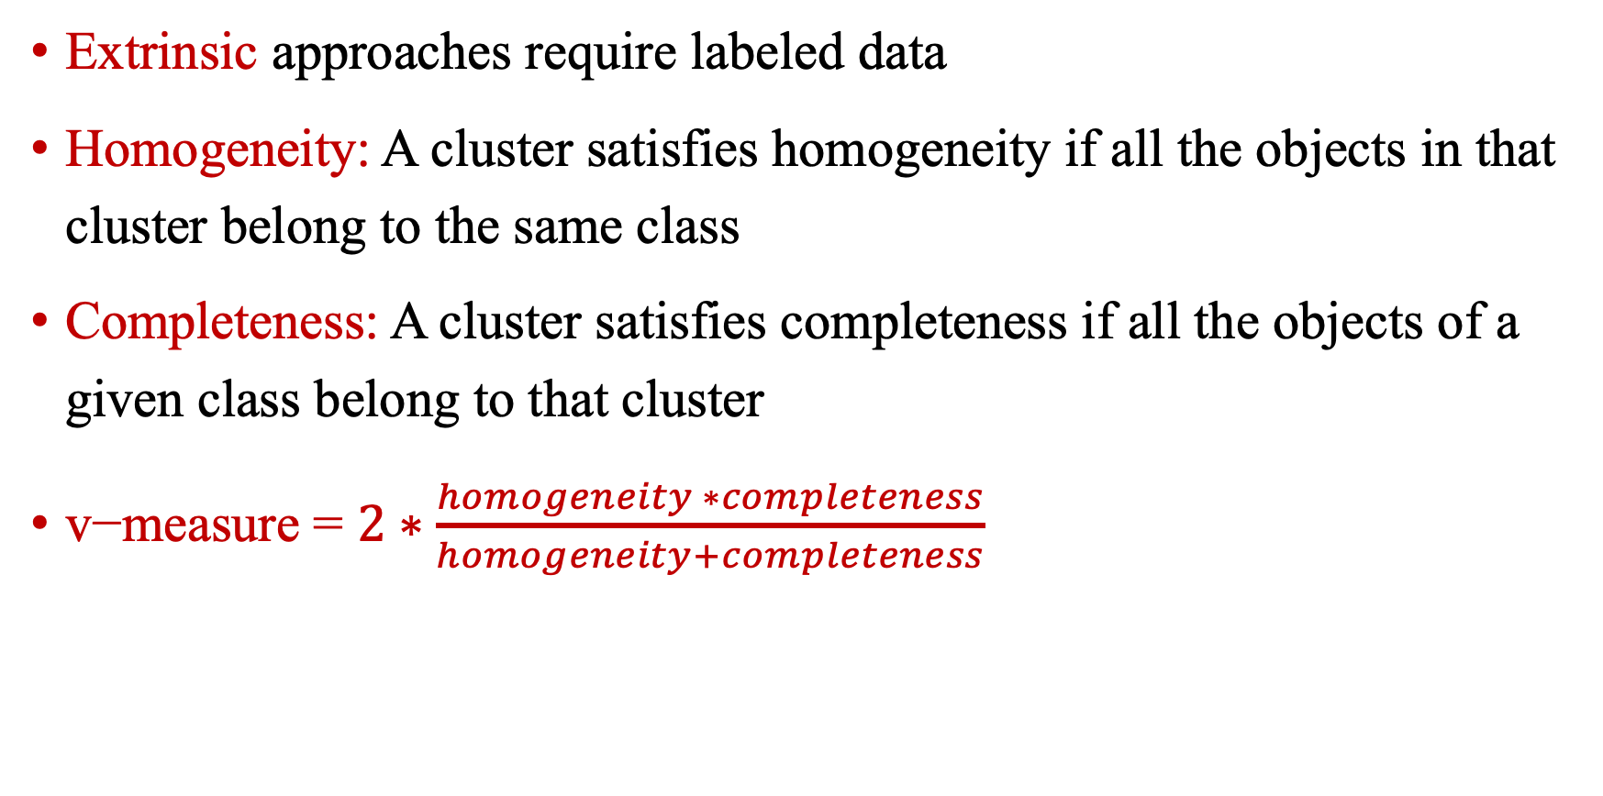
Measuring the Clustering Quality – Extrinsic Approaches
Extrinsic approaches require labeled data
Homogeneity: A cluster satisfies homogeneity if all the objects in that cluster belong to the same class
Completeness: A cluster satisfies completeness if all the objects of a given class belong to that cluster
$\text{v}\text{−}\text{measure}\text{ = }2∗\frac{homogeneity ∗completeness}{homogeneity+completeness}$

Slide 49
Measuring the Clustering Quality –
Extrinsic Approaches
Example: let the dataset D has class labels [0,0,1,1]
If we cluster them to [1,1,0,0] let h = homogeneity, c = completeness then h = 1 and c = 1 so v-measure = 1.
All the objects with class label 0 assigned to cluster with label 1, and objects with label 1 assigned to cluster 0. Clusters satisfy both homogeneity and completeness
e4
e2
e3
e1
e2
e1
e3
e4
Original
After the clustering

Slide 50
Measuring the Clustering Quality – Extrinsic Approaches
Homogeneity, completeness and v-measure take values in [0,1]
Small values = poor clustering
large values = pure clustering
You can find these values using the Python scikit-learn package:
metrics.homogeneity_score
metrics.completeness_score and
metrics.v_measure_score

Slide 51
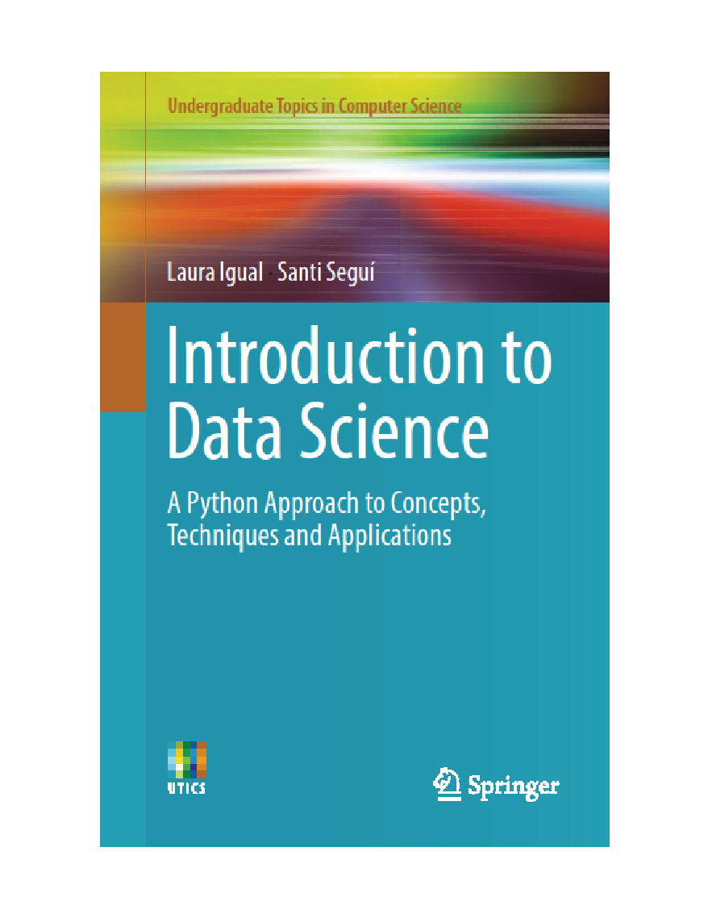
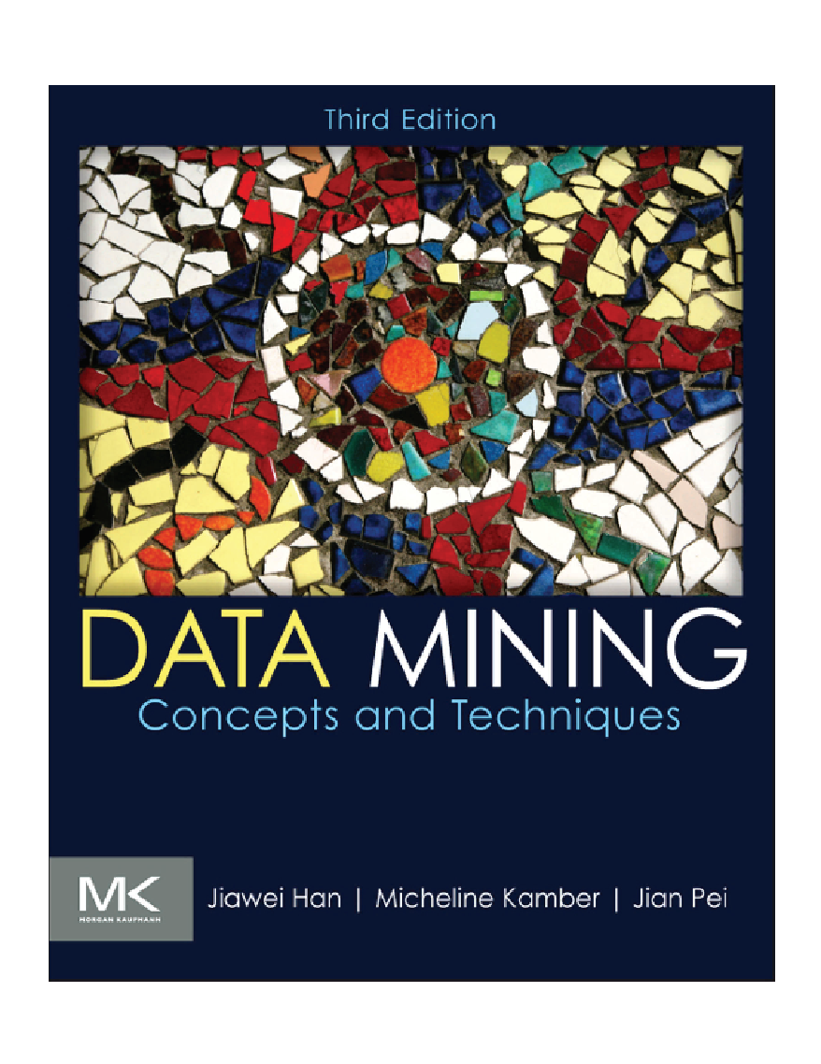
Reading Material for Interested Students
Introduction to Data Science, Ch 7. Unsupervised Learning
Data Mining: Concepts-and-Techniques Ch 10. Cluster Analysis

Slide 52

Wrap-Up
Summerize what you learned today in 2-minutes

